Slide 1
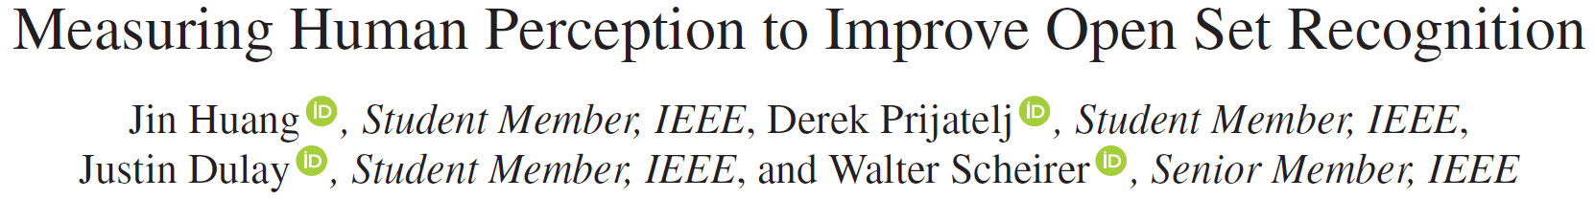
Published in PAMI 2023 Sep
Presented by Mingle Xu
2023 Dec 19
Jeonbuk National University

Slide 2
Content
Observation: knowledge-guided method
Motivation: using prior information in deep learning and AI
Paradigm of AI
Symbolic AI
Connectionist AI
AI 3.0: combination of symbolic and connectionist AI
Taxonomy of knowledge
Mental imagery
For open set recognition (this paper)

Slide 3
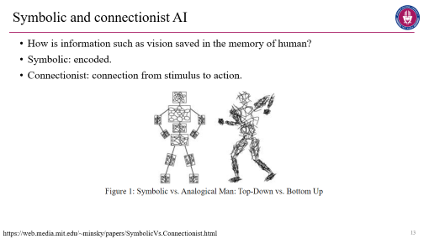
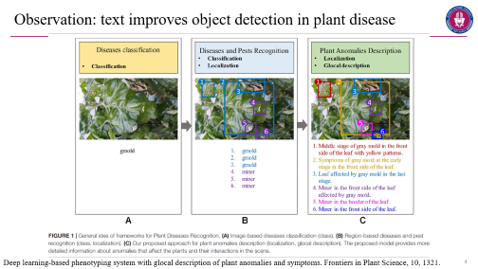

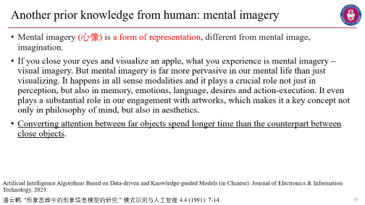
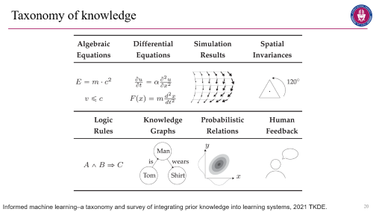
Observation
Observation
History
Taxonomy
Mental imagery
Knowledge in OSR

Slide 4
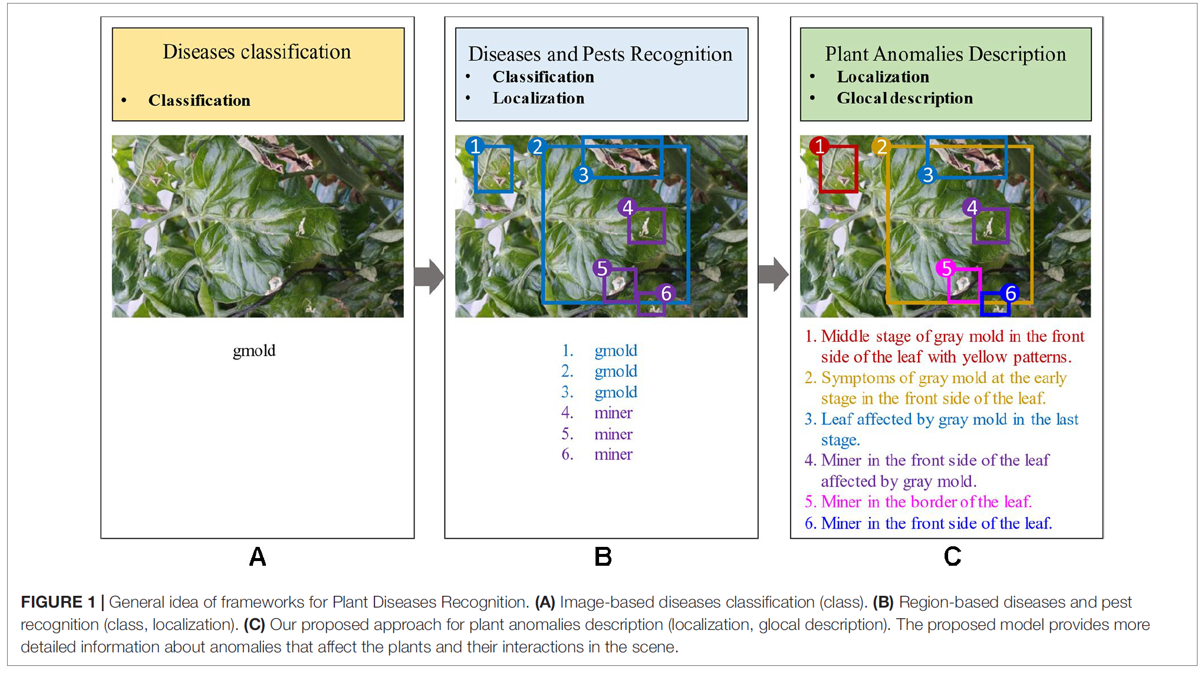
Observation: text improves object detection in plant disease
Deep learning-based phenotyping system with glocal description of plant anomalies and symptoms. Frontiers in Plant Science, 10, 1321.

Slide 5
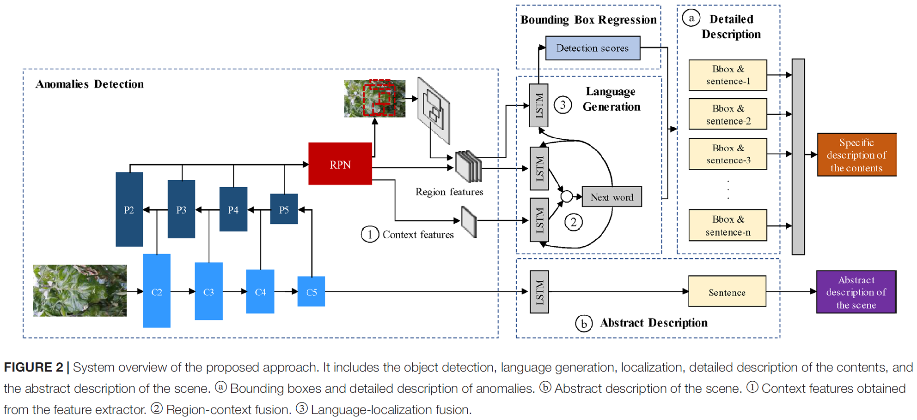
Deep learning-based phenotyping system with glocal description of plant anomalies and symptoms. Frontiers in Plant Science, 10, 1321.

Slide 6
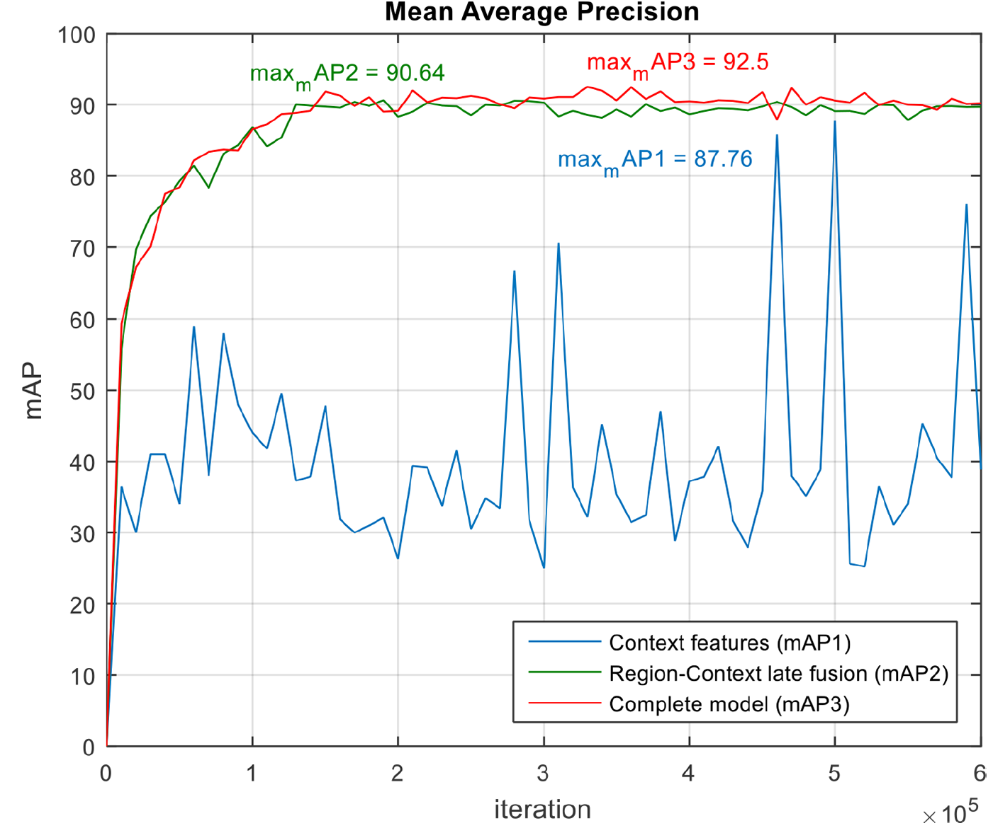
Compared to class, text may give additional information.
Text is beneficial to object detection.
Deep learning-based phenotyping system with glocal description of plant anomalies and symptoms. Frontiers in Plant Science, 10, 1321.

Slide 7
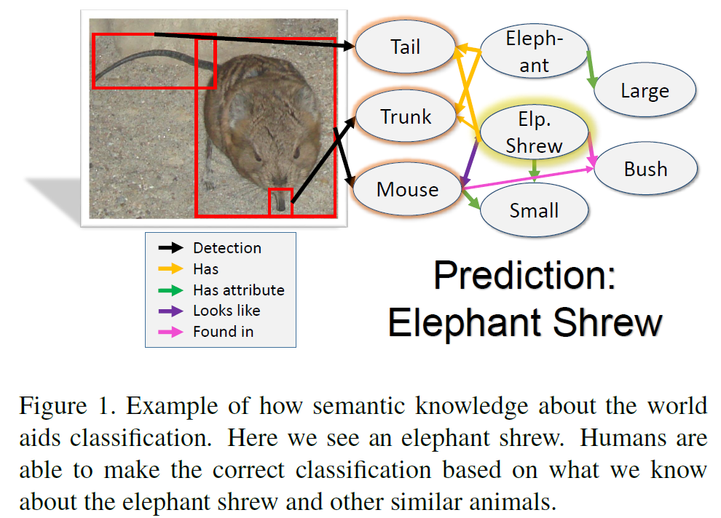
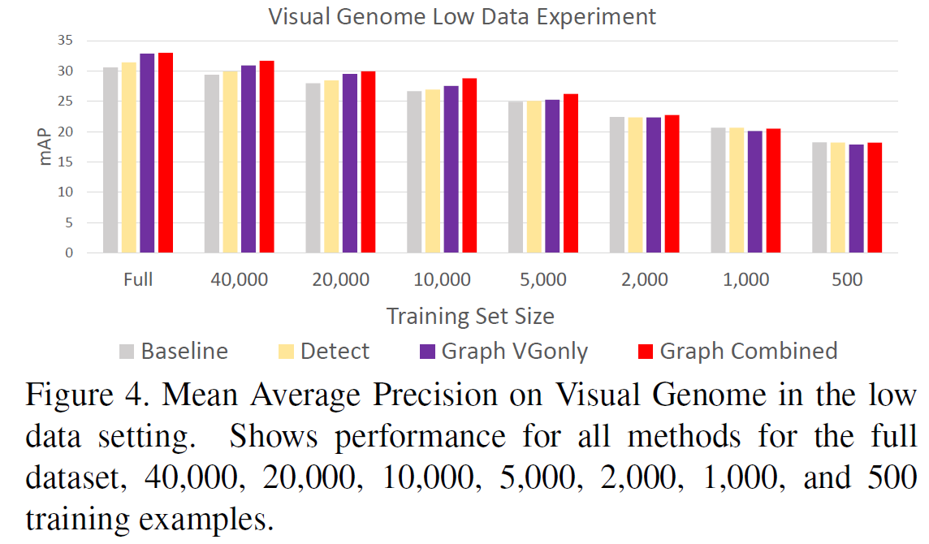
Observation: knowledge graph benefits multi-label classification
Visual Genome dataset, a knowledge graph dataset with sentences.
WordNet dataset, a large lexical database of English.
The More You Know: Using Knowledge Graphs for Image Classification. In 2017 CVPR.

Slide 8
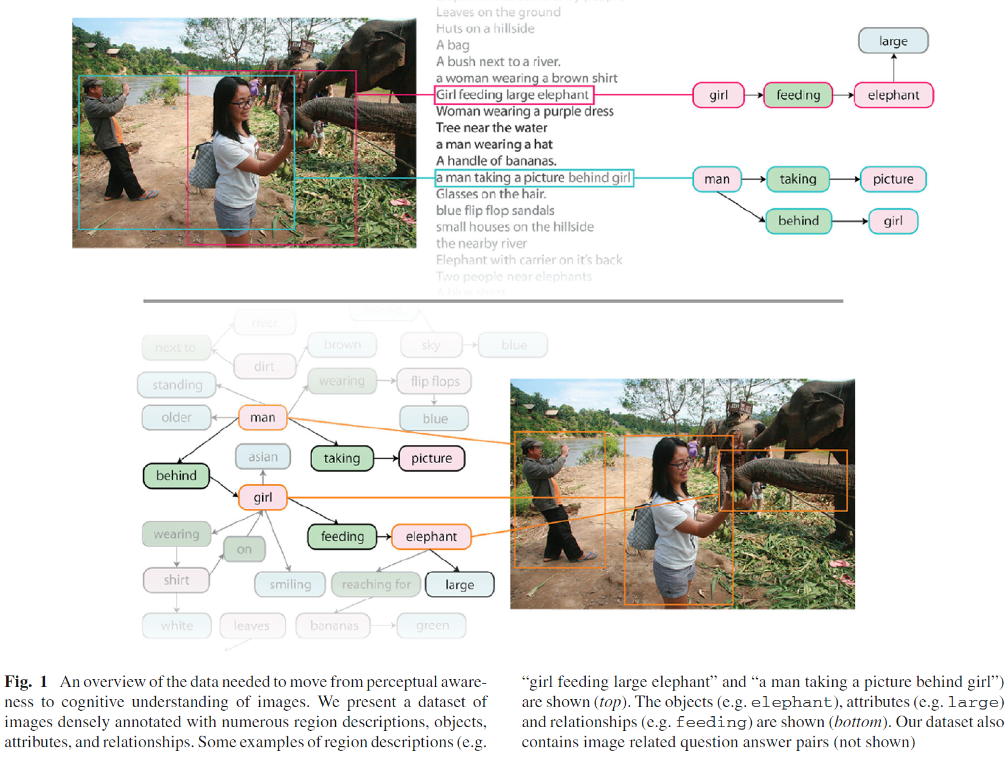
Visual Genome dataset
Visual Genome Connecting Language and Vision Using Crowdsourced Dense Image Annotations, 2017 IJCV.

Slide 9
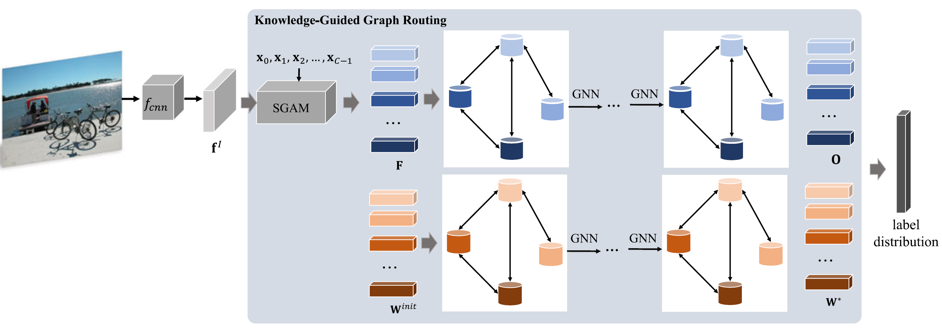
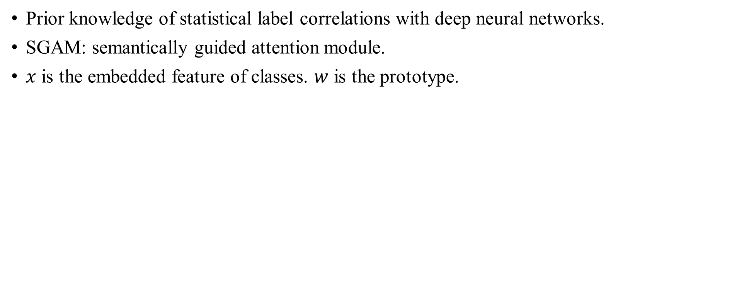
Observation: label correlation contributes to multi-label classification
Prior knowledge of statistical label correlations with deep neural networks.
SGAM: semantically guided attention module.
$x$ is the embedded feature of classes. $w$ is the prototype.
Knowledge-guided multi-label few-shot learning for general image recognition, 2020 PAMI.

Slide 10
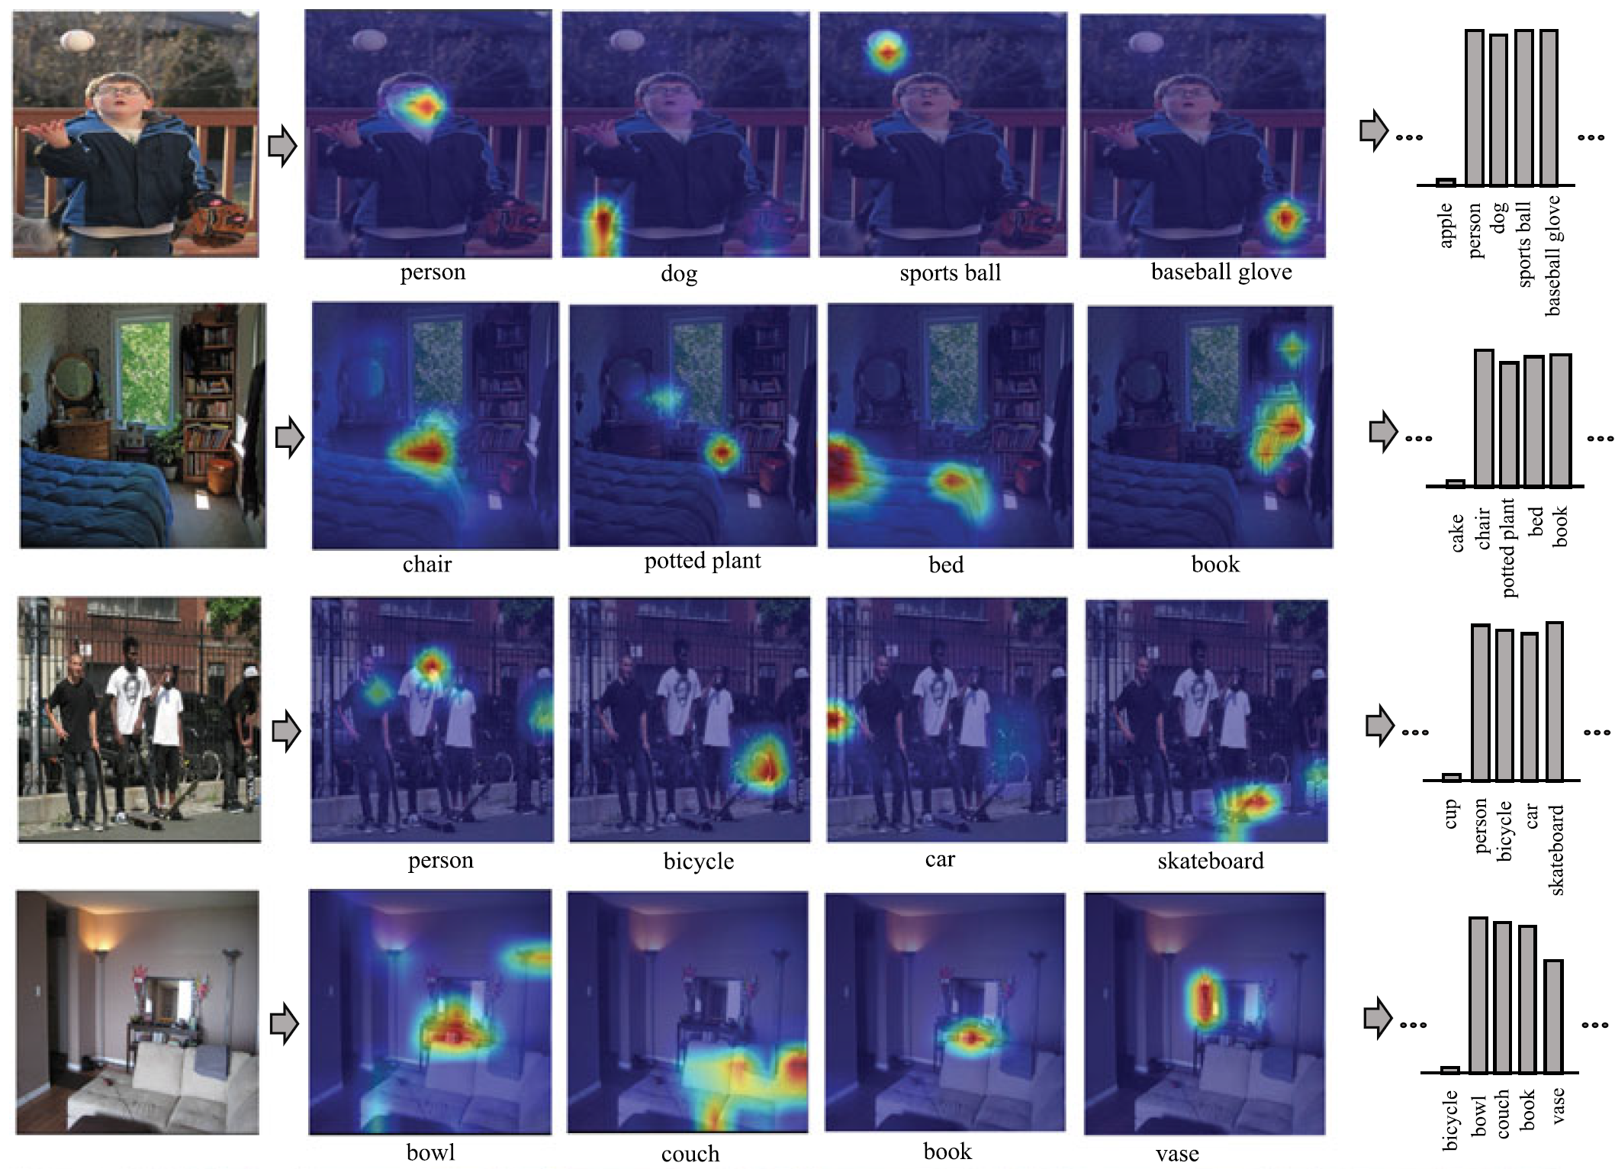
Knowledge-guided multi-label few-shot learning for general image recognition, 2020 PAMI.

Slide 11
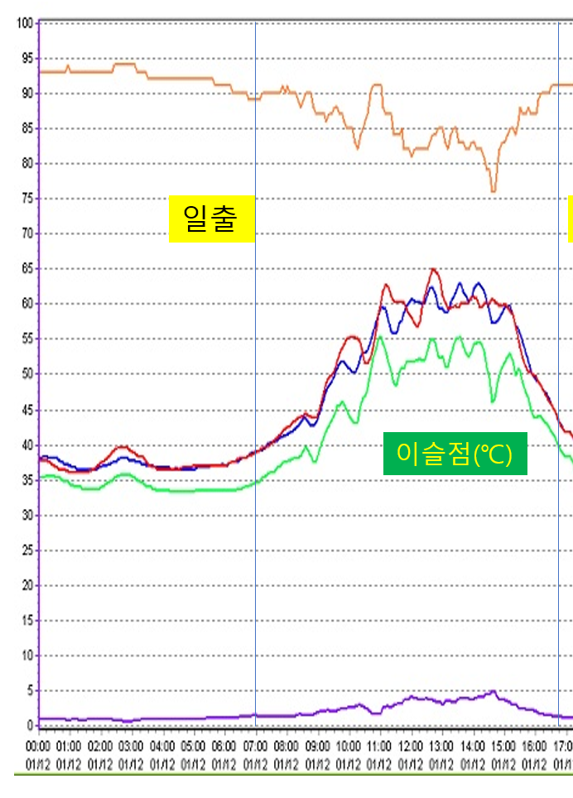
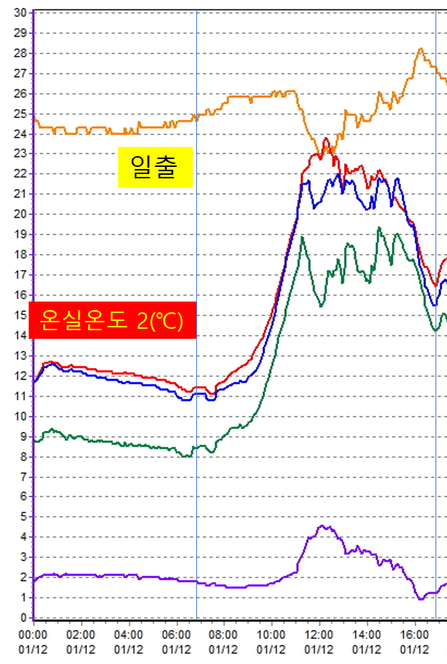
Plant growth dataset is also related to knowledge

Slide 12
Knowledge were used long time ago.

Slide 13
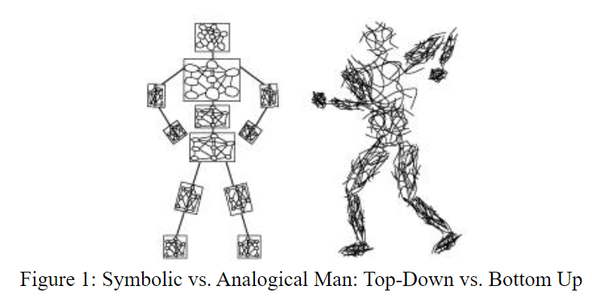
Symbolic and connectionist AI
How is information such as vision saved in the memory of human?
Symbolic: encoded.
Connectionist: connection from stimulus to action.
https://web.media.mit.edu/~minsky/papers/SymbolicVs.Connectionist.html

Slide 14
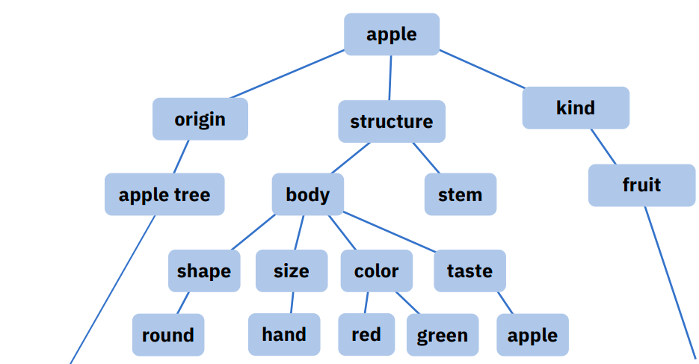
Symbolic AI, knowledge and experience
Knowledge engineering and expert systems, such as Deep Blue.
With machine learning, inductive learning based on knowledge.
Advantages:
Easier to be understand by human, based on Psychology Theory.
Good generalization ability.
Data-efficient.
Disadvantages:
Without strong mathematics, such as few mathematic tool.
Knowledge representation is hard.
https://web.media.mit.edu/~minsky/papers/SymbolicVs.Connectionist.html.
Toward the third generation of artificial intelligence (in Chinese). Sci Sin Inform, 2020.

Slide 15
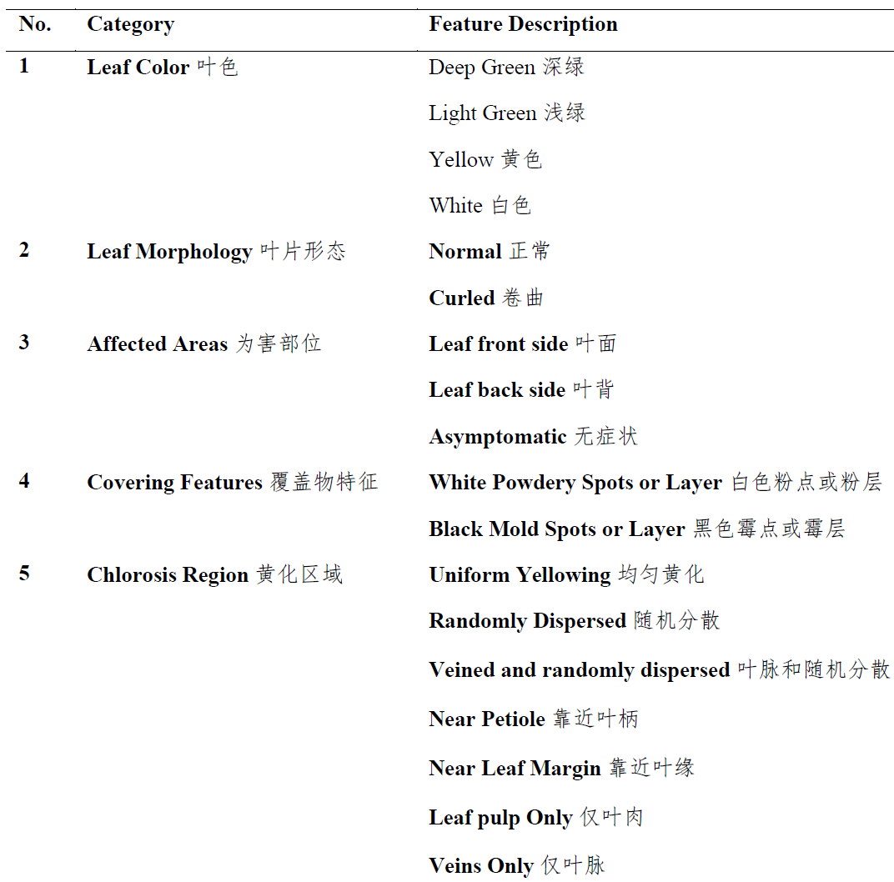
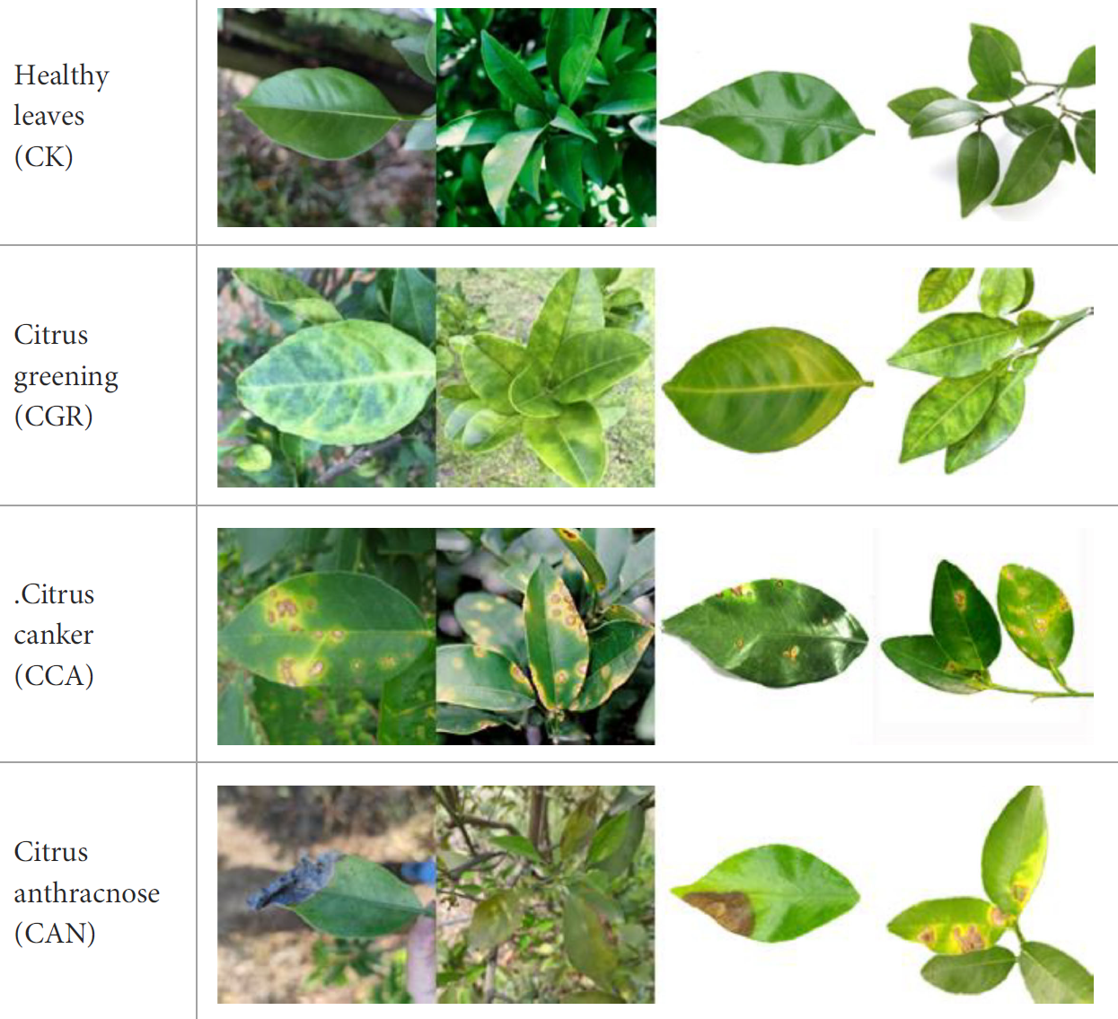
Knowledge of citrus disease.
Detection of citrus diseases in complex backgrounds based on image–text multimodal fusion and knowledge assistance. Frontiers in Plant Science, 2023.

Slide 16
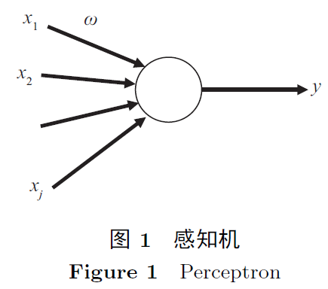
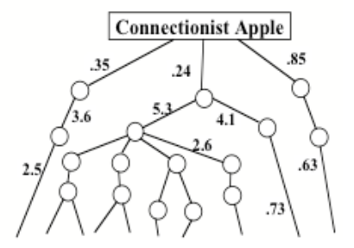
Connectionist AI
Disadvantages:
Difficult to be understand by human.
Bad generalization ability, easy to be attacked.
Data-inefficient.
Advantages:
With strong mathematics, such as optimization learning.
Feature representation is easy to be executed by machines.
https://web.media.mit.edu/~minsky/papers/SymbolicVs.Connectionist.html.
Toward the third generation of artificial intelligence (in Chinese). Sci Sin Inform, 2020.

Slide 17
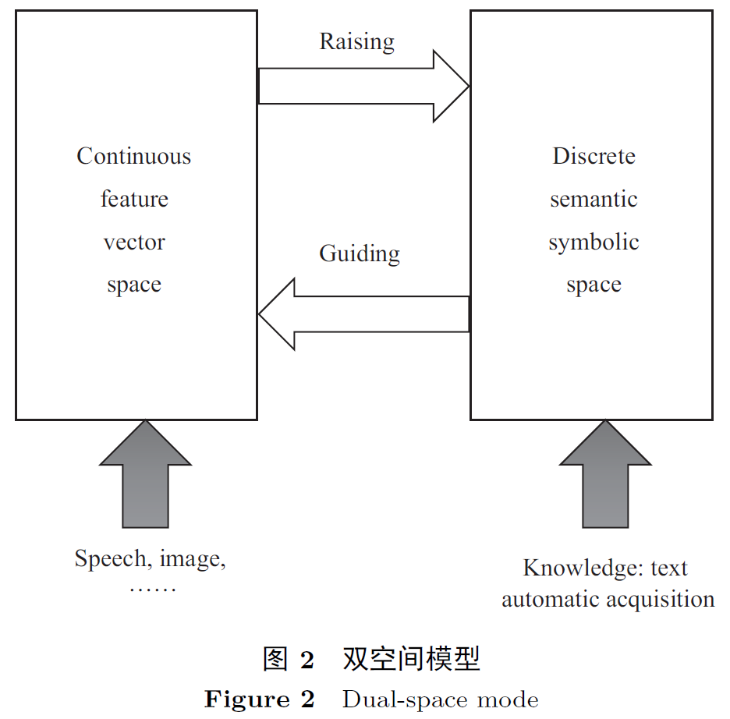
What is the future?
Symbolic AI: knowledge + algorithm + computation. Knowledge-driven.
Connectionist AI: data + algorithm + computation. Data-driven.
Two spaces: feature and semantic spaces.
AI 3.0: knowledge + data + algorithm + computation.
Basic challenge: the gap between the continuous feature space of machine and raw data and the discrete semantic space of human.
Toward the third generation of artificial intelligence (in Chinese). Sci Sin Inform, 2020.

Slide 18
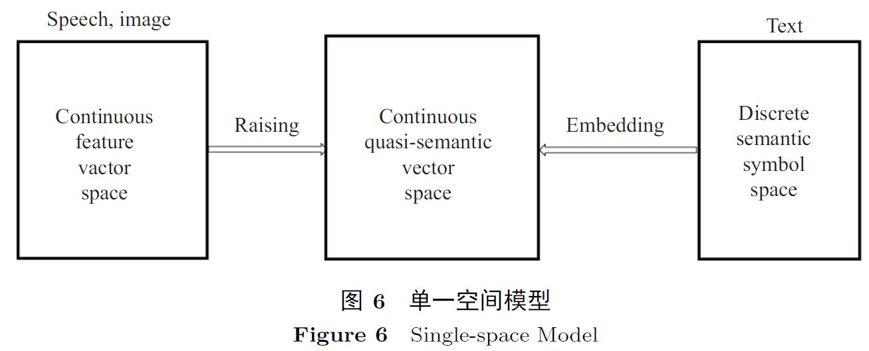
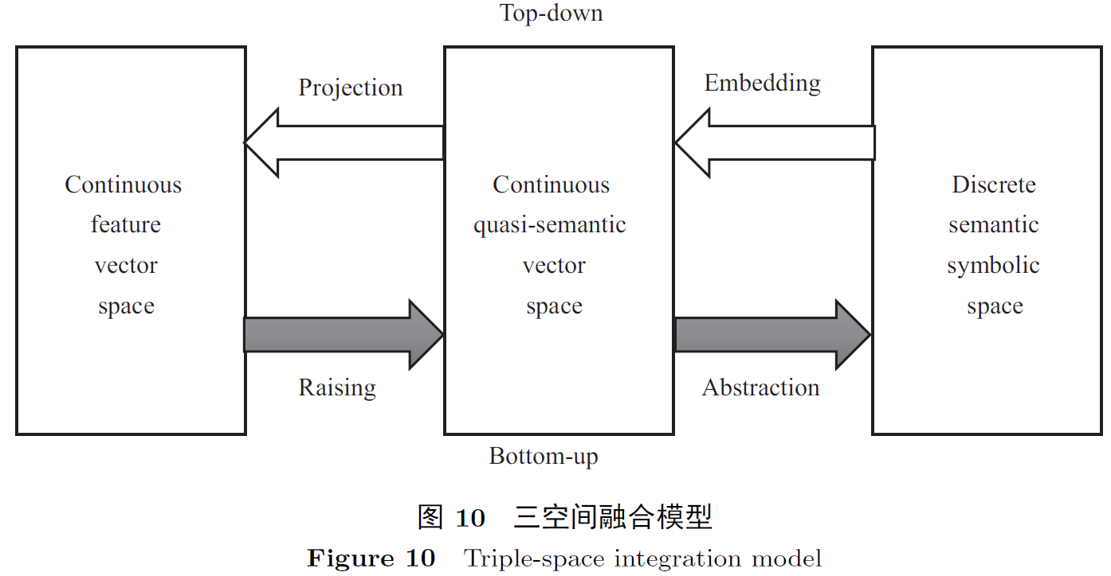
Toward the third generation of artificial intelligence (in Chinese). Sci Sin Inform, 2020.

Slide 19
What is it and how to use it?
What is the knowledge and its taxonomy?
Knowledge is already utilized in deep learning, implicitly.

Slide 20
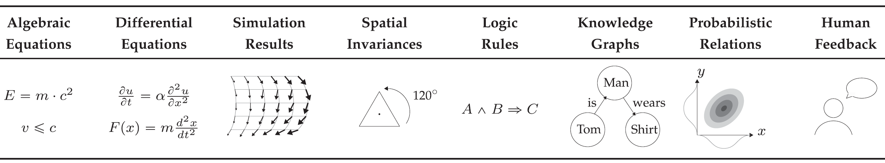
Taxonomy of knowledge
Informed machine learning–a taxonomy and survey of integrating prior knowledge into learning systems, 2021 TKDE.

Slide 21
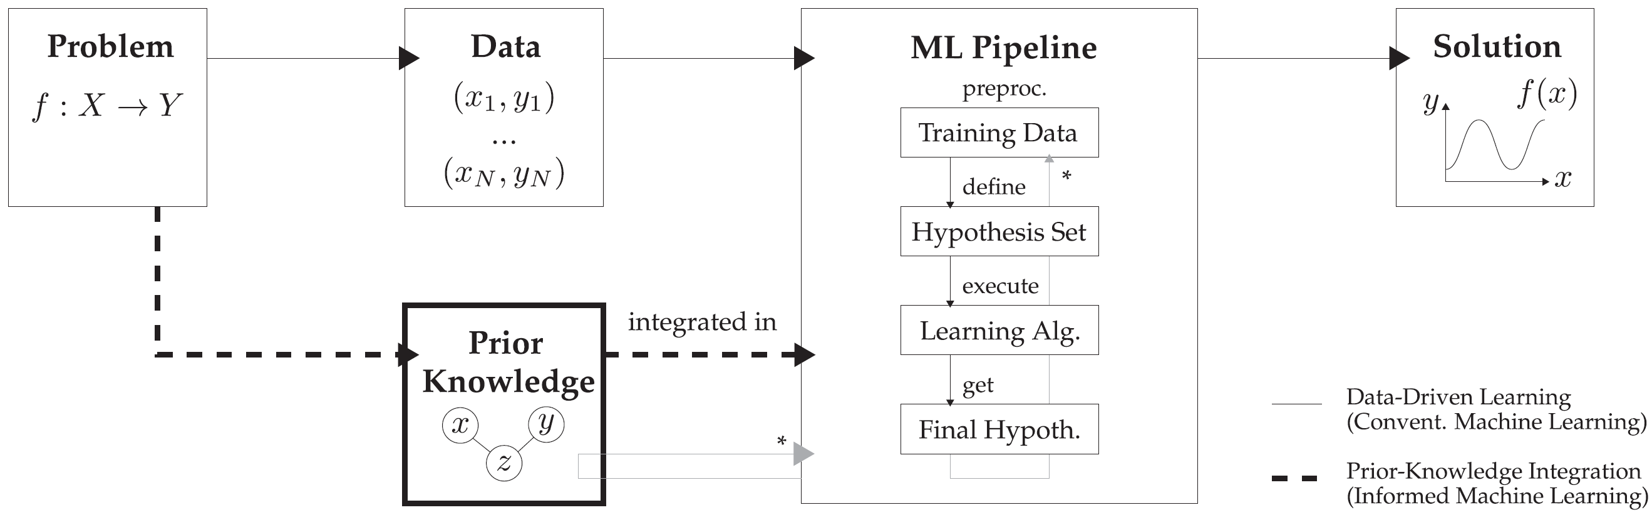
Pipeline to use data and knowledge
Informed machine learning–a taxonomy and survey of integrating prior knowledge into learning systems, 2021 TKDE.

Slide 22
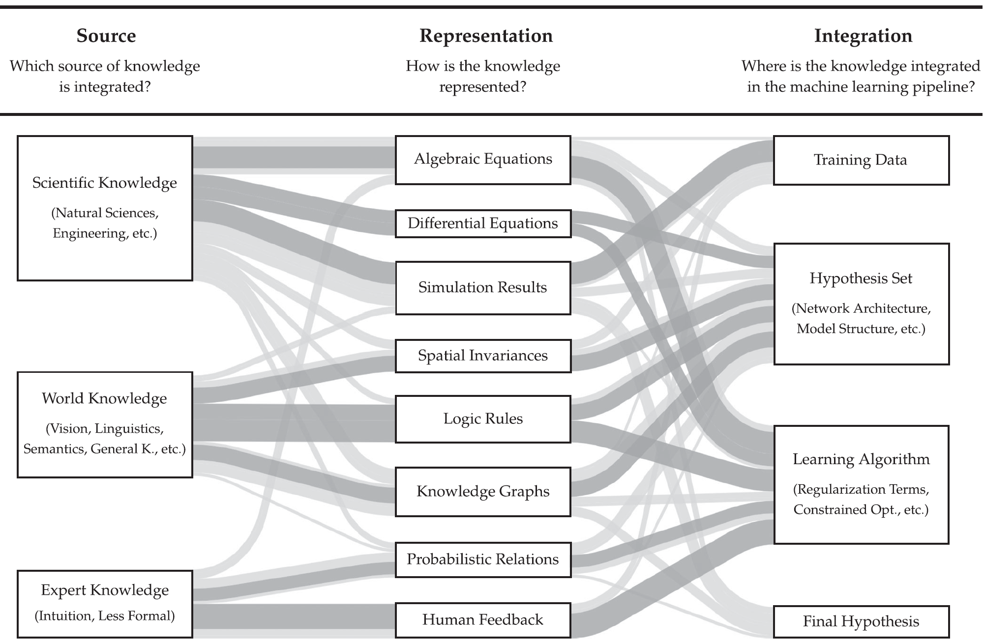
Informed machine learning–a taxonomy and survey of integrating prior knowledge into learning systems, 2021 TKDE.

Slide 23
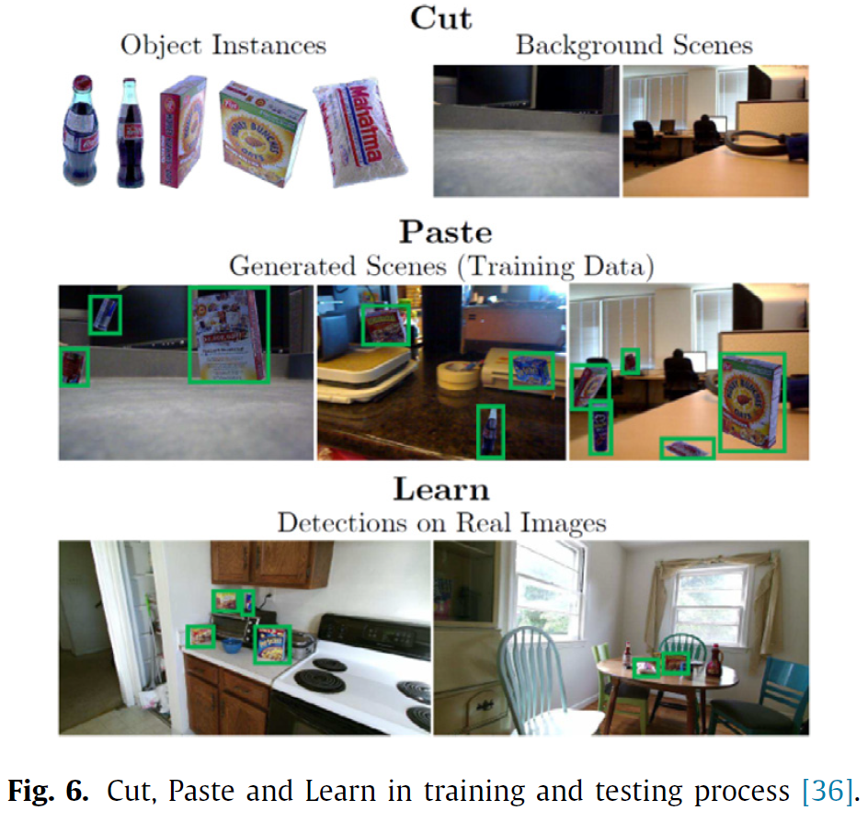
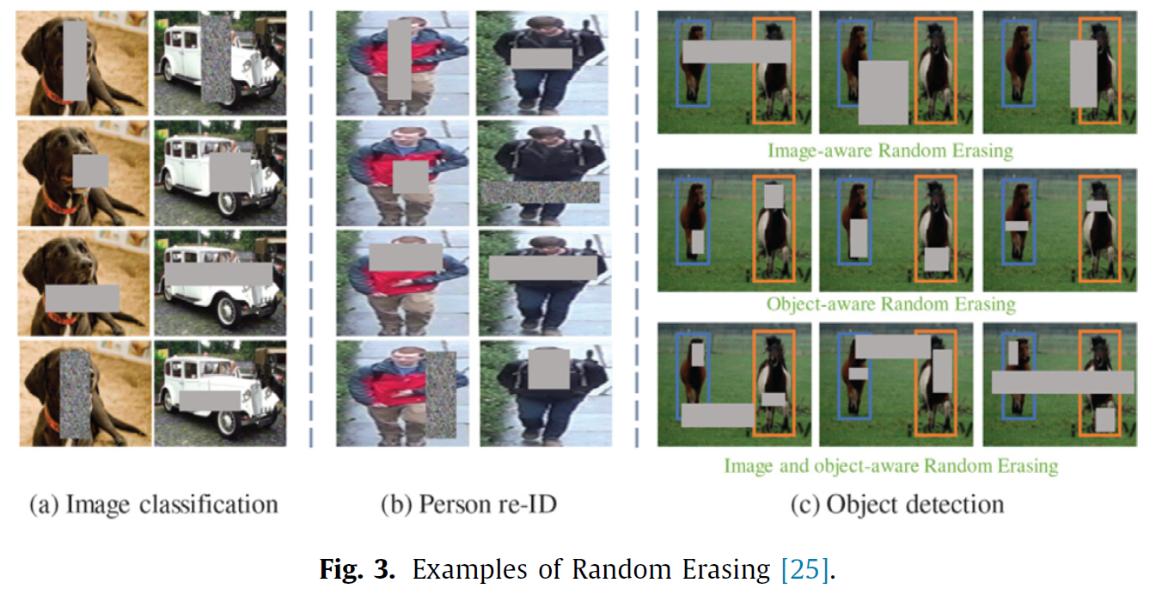
Dataset and data augmentation
To get a decent performance, size of dataset partly depends on the complexity of problem.
Data augmentation method: vertical flip is not ok for MNIST.
Random erasing and occlusion.
Copy and paste and class imbalance.
A comprehensive survey of image augmentation techniques for deep learning. PR, 109347.

Slide 24
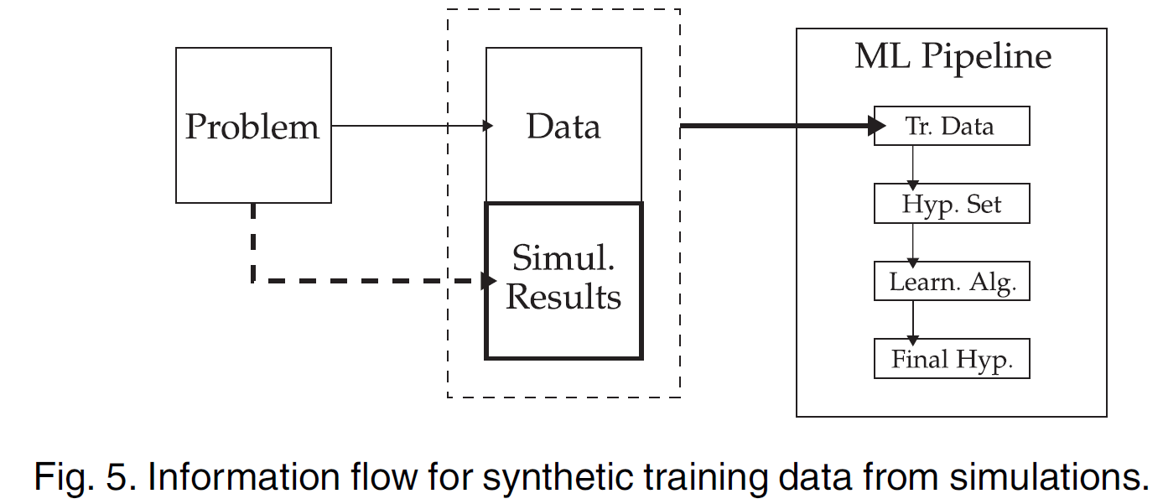
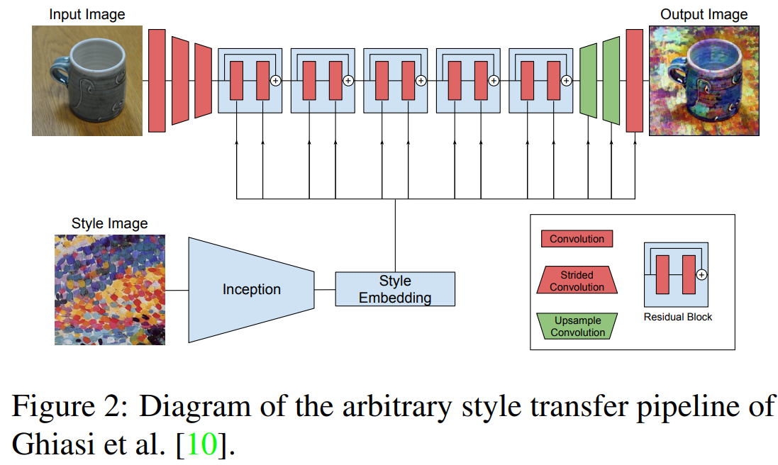
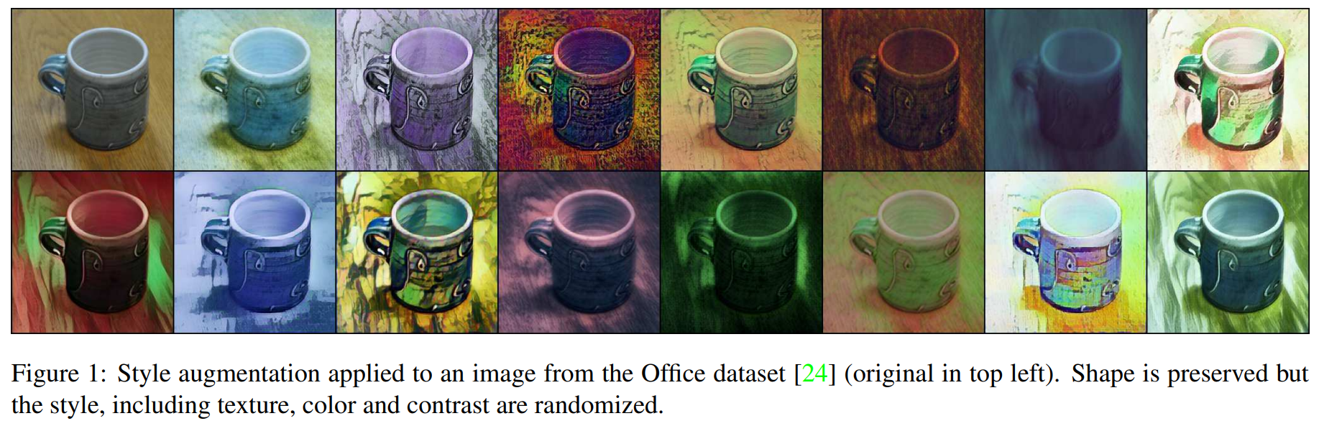
Simulation: style transfer as data augmentation
Informed machine learning–a taxonomy and survey of integrating prior knowledge into learning systems, 2021 TKDE.
Stada: Style transfer as data augmentation, 2019 CVPRW.

Slide 25
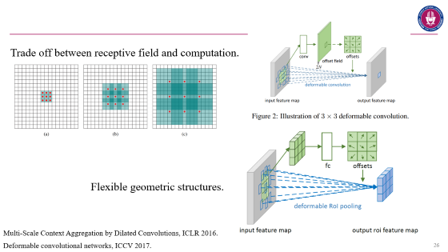
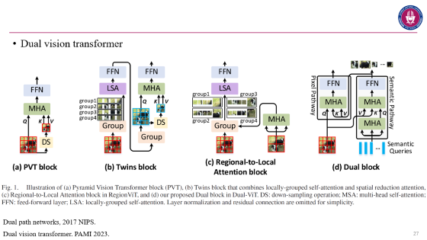
Model architecture and knowledge
CNN: visual characteristics, local connection and shared weight.
Dilated CNN.
Deformable CNN.
Dual path CNN, thinking quick and slow, subconscious and deliberate thinking
Attention and transformer: spatial correlation in local and global.
LSTM: temporary correlation.
Number of layers: complexity of problems.
Regularization, such as sparse feature.

Slide 26
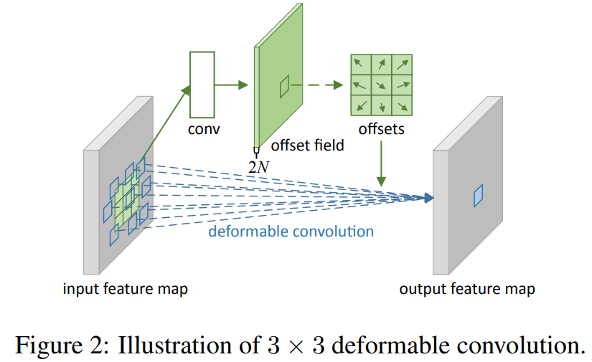
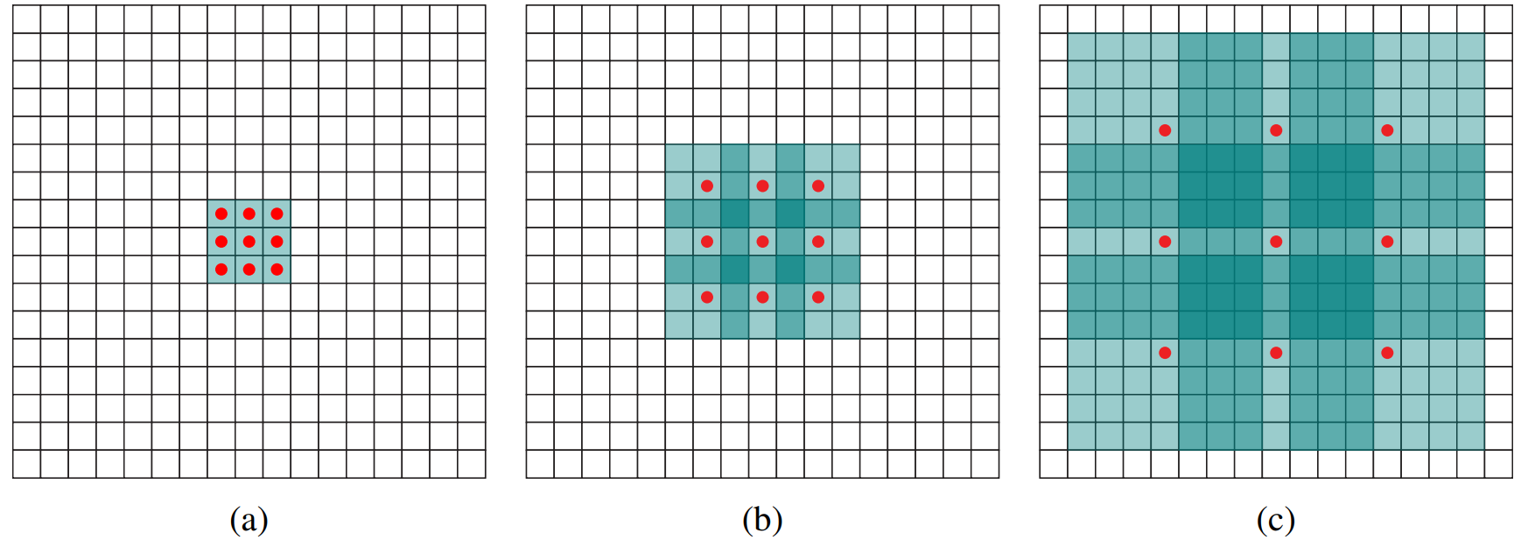
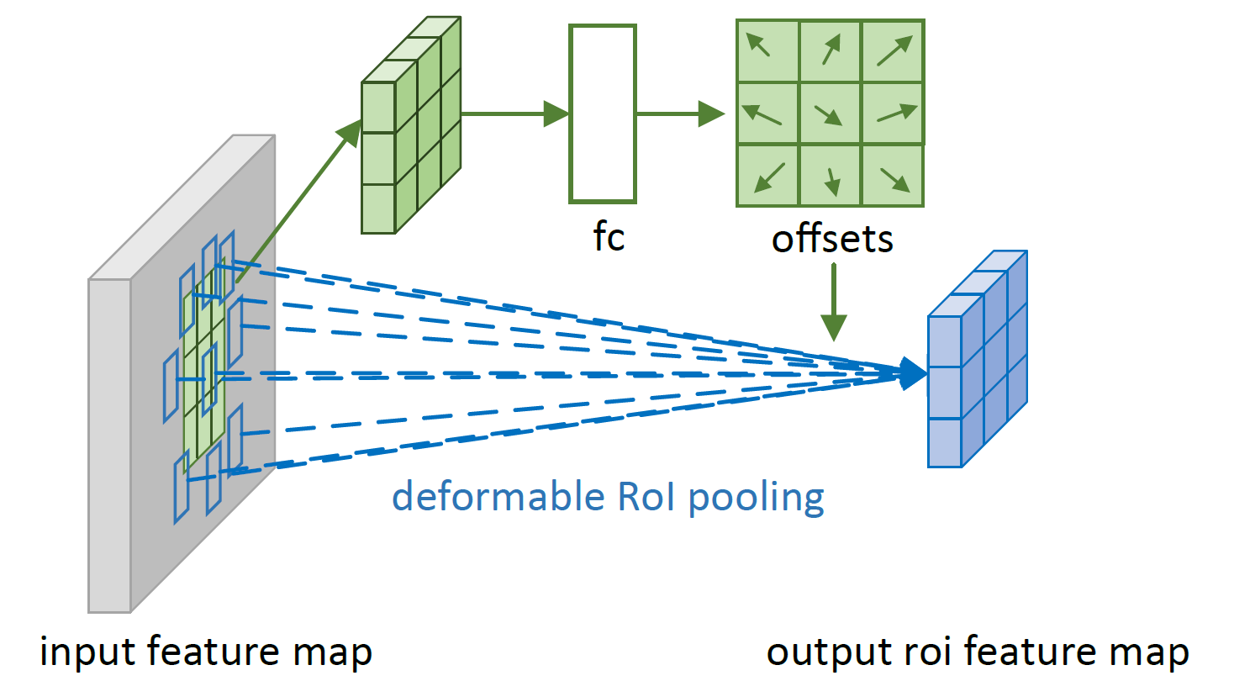
Trade off between receptive field and computation.
Flexible geometric structures.
Multi-Scale Context Aggregation by Dilated Convolutions, ICLR 2016.
Deformable convolutional networks, ICCV 2017.

Slide 27
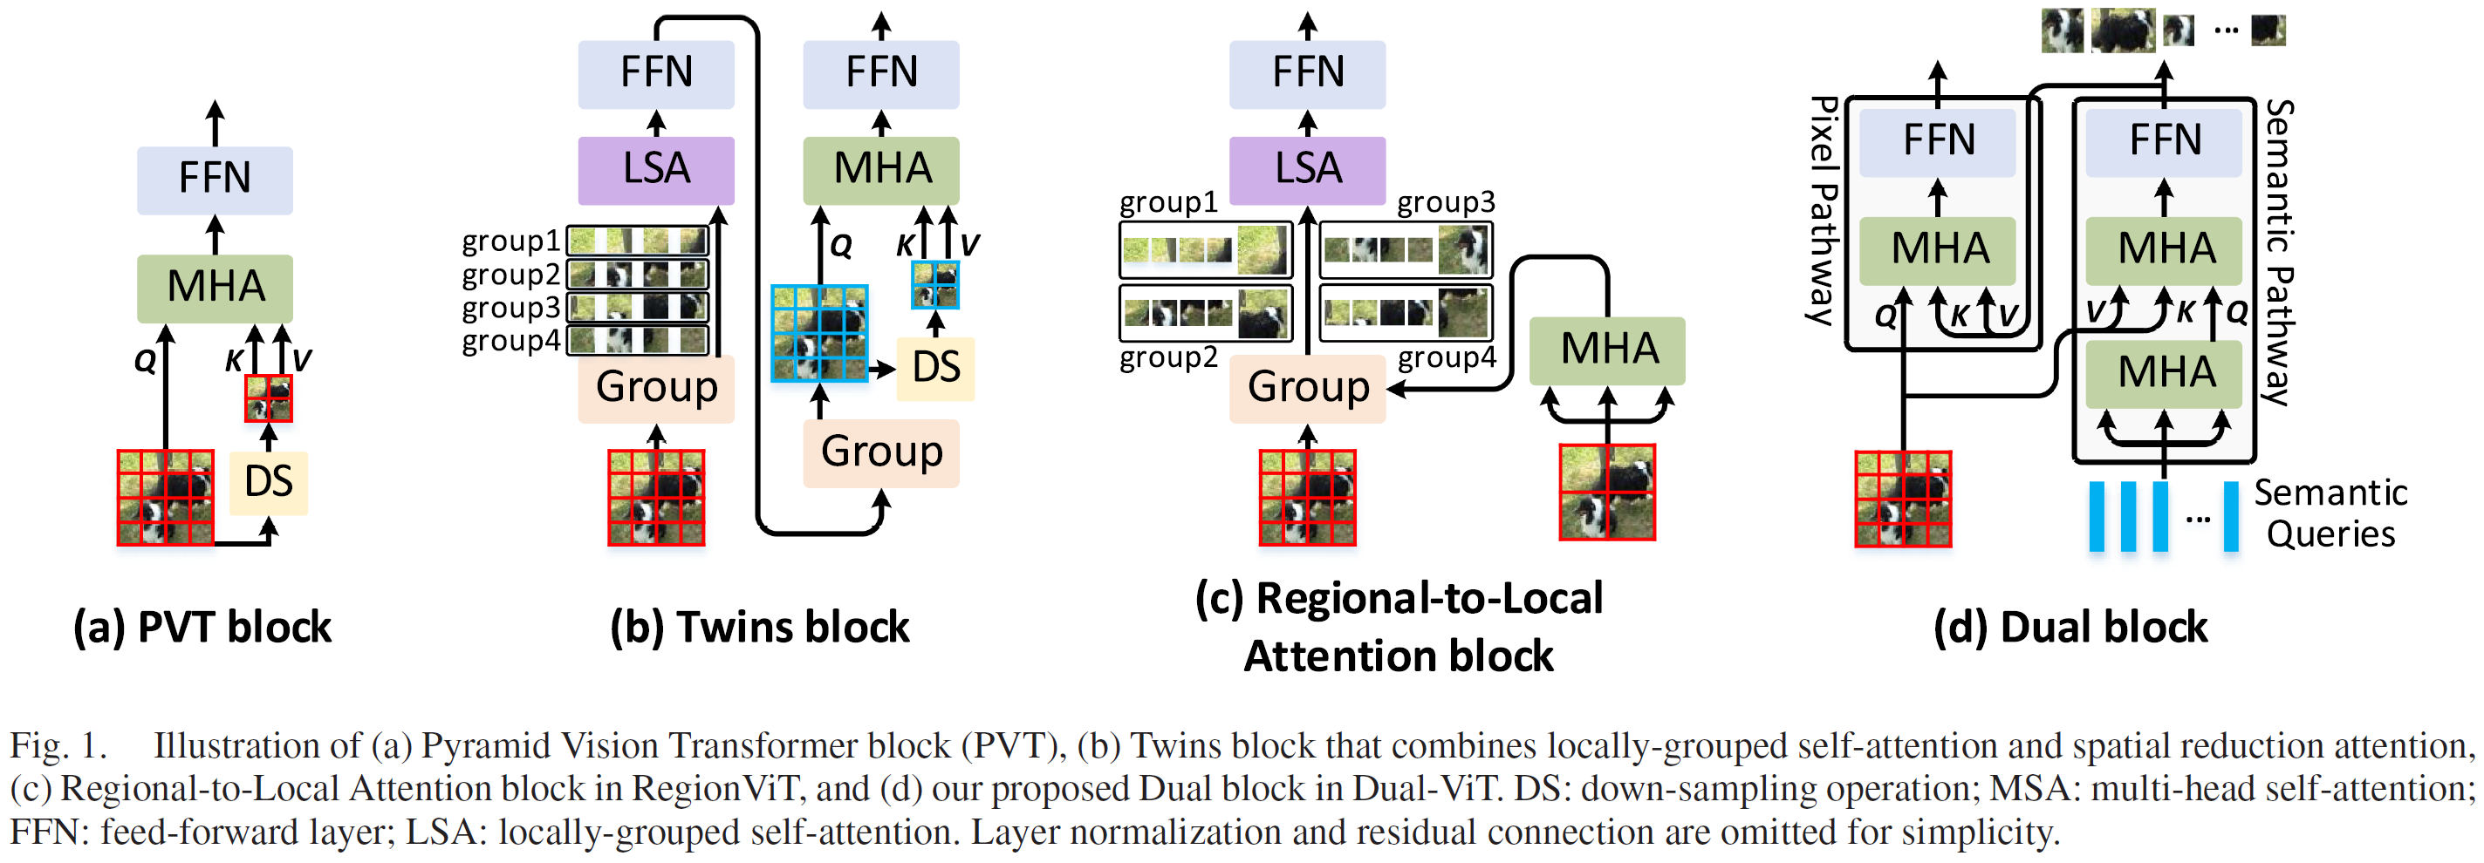
Dual vision transformer
Dual path networks, 2017 NIPS.
Dual vision transformer. PAMI 2023.

Slide 28
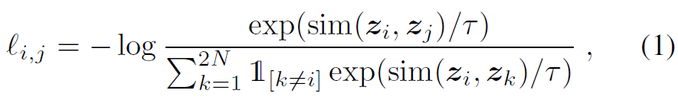
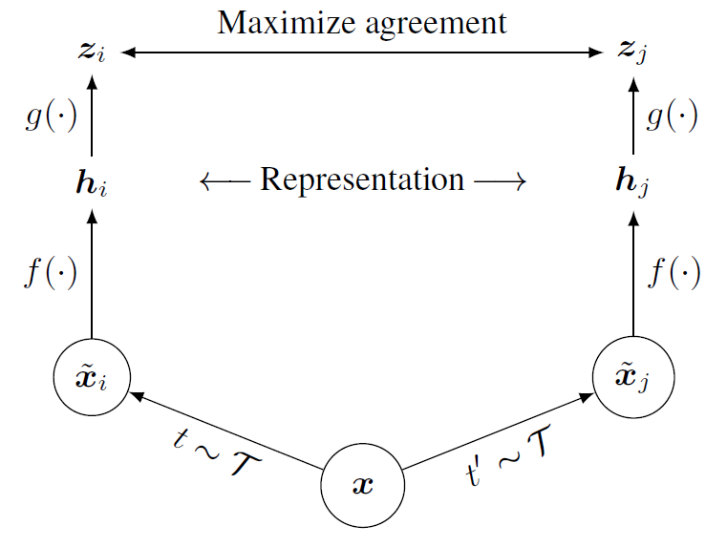
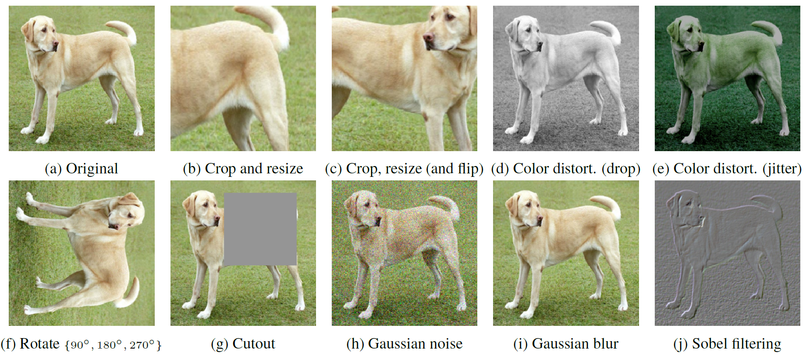
Loss function
Self-supervised learning: data augmentation does not change the semantic class.
A Simple Framework for Contrastive Learning of Visual Representations, ICML2020.

Slide 29
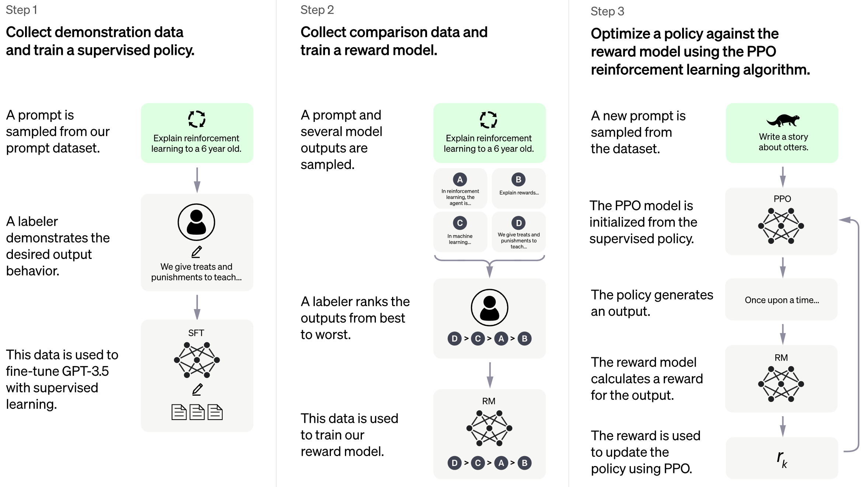
Human feedback in the training of ChatGPT
https://openai.com/blog/chatgpt?ref=assemblyai.com

Slide 30
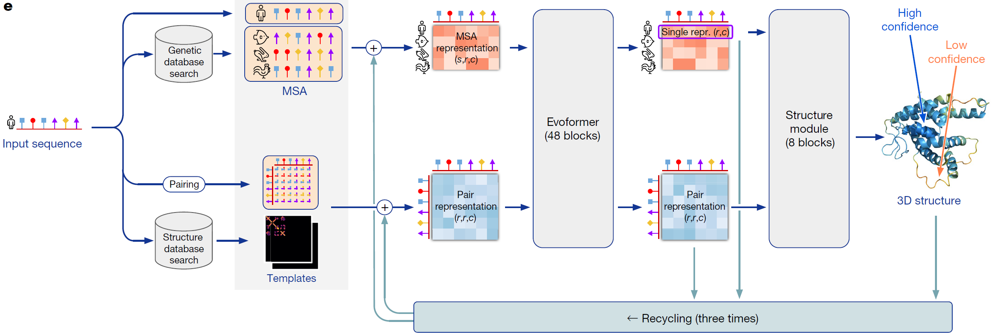
Attention and prior information in AlphaFold2
Highly accurate protein structure prediction with AlphaFold. Nature, 2021.

Slide 31
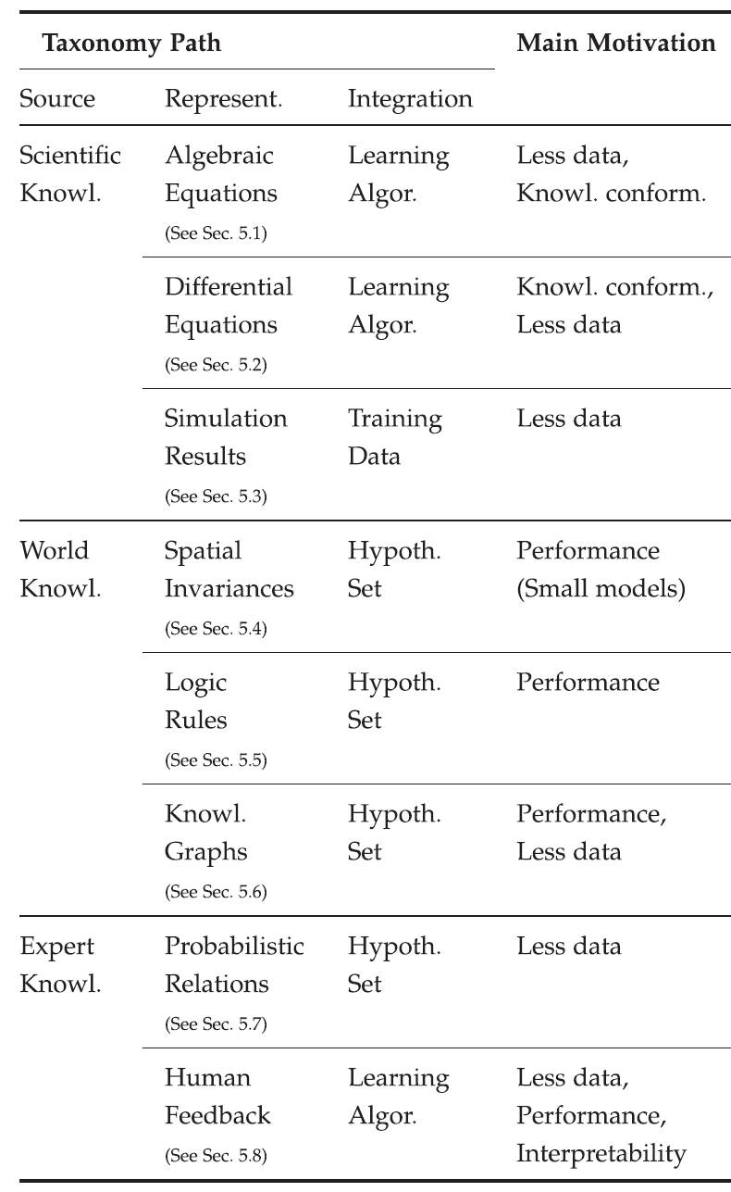
Motivation to use knowledge
Generalization ability.
Informed machine learning–a taxonomy and survey of integrating prior knowledge into learning systems, 2021 TKDE.

Slide 32
Current situation of knowledge-guided method, width of the lines
Informed machine learning–a taxonomy and survey of integrating prior knowledge into learning systems, 2021 TKDE.

Slide 33
Another prior knowledge from human: mental imagery
Mental imagery (心像) is a form of representation, different from mental image, imagination.
If you close your eyes and visualize an apple, what you experience is mental imagery – visual imagery. But mental imagery is far more pervasive in our mental life than just visualizing. It happens in all sense modalities and it plays a crucial role not just in perception, but also in memory, emotions, language, desires and action-execution. It even plays a substantial role in our engagement with artworks, which makes it a key concept not only in philosophy of mind, but also in aesthetics.
Converting attention between far objects spend longer time than the counterpart between close objects.
Artificial Intelligence Algorithms Based on Data-driven and Knowledge-guided Models (in Chinese). Journal of Electronics & Information Technology, 2023.
潘云鹤. "形象思维中的形象信息模型的研究." 模式识别与人工智能 4.4 (1991): 7-14.

Slide 34
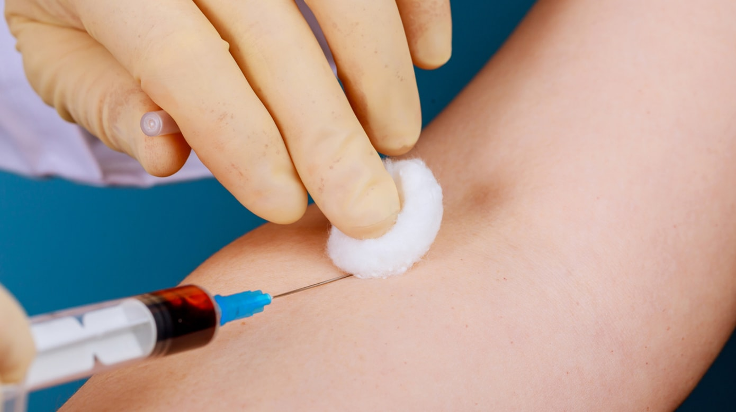
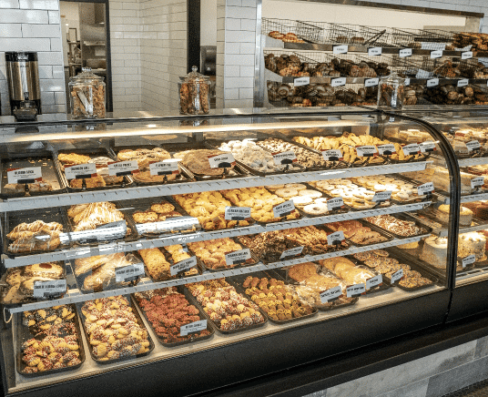
Some examples of mental imagery
Vision and memory
Smell would make you hungry

Slide 35
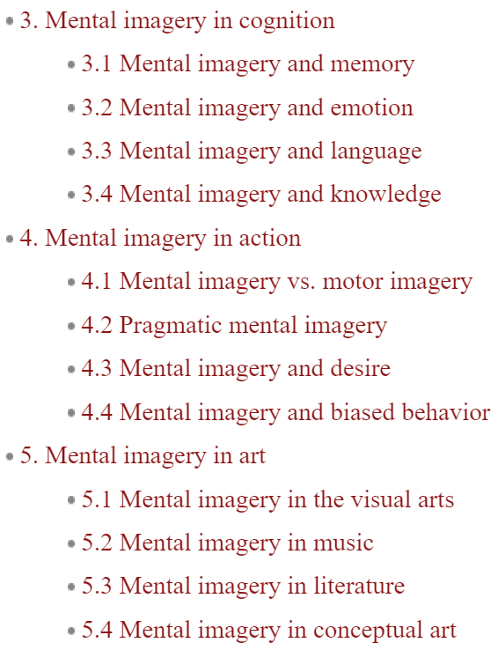
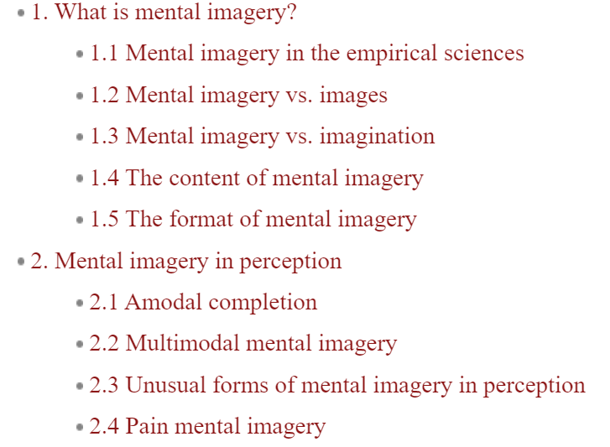
https://plato.stanford.edu/entries/mental-imagery/#MentImagEmpiScie.

Slide 36
Published in PAMI 2023 Sep
Presented by Mingle Xu
2023 Dec 19
Jeonbuk National University

Slide 37
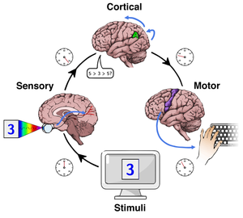
Reaction time
Reaction time and is related to visual psychophysics and mental imagery.
It reveal patterns of difficulty in the data.
It is fast to recognize something familiar and similar.
More ambiguous cases will take longer to be recognized.
https://en.wikipedia.org/wiki/Mental_chronometry

Slide 38
Dataset collection
Amazon Mechanical Turk (AMT) to collect human reaction time (RT).
A subset of ImageNet-1k, contains 335 classes.
Known classes: in both training and test time. 293 classes.
Unknown classes: not labeled, and unseen in the training, randomly choose 42 classes.
Randomly chose 40 classes from the known classes to do human behavior experiments.

Slide 39

Training and test data for human.

Slide 40
Only two classes are selected from the known classes in human experiments at a time in a question. For each pair, 20 questions are created and thus 1,600 sets of different surveys in total.
RT on known samples provides more information on what is non-novel beyond a class label.
Training images for machine learning task are drawn from the correct known class images from the second rows.
Instance level, 211,074 RT measures in total. After data cleaning and pre-processing, 121,073 left. An image may exist in multiple instances.
33,548 training samples from 40 known classes and 12,428 images among them have corresponding RTs.

Slide 41


Slide 42
How to utilize the RTs?
Enforce human RTs in a model that supports dynamic reaction time during runtime.
Easy to recognize → smaller RT, and model should be quick to get classification.

Slide 43

Training stage
MSD-Net: multi-scale DenseNet.
Multiple classifiers.
RTs are split into 5 bins.
Training with 5 thresholds initialized as zero.
To update the thresholds, validation data are used after every 5 epochs at each exit.
If the network produces a prediction score that is above the threshold and outputs a correct prediction, a sample is considered to be exiting the network.

Slide 44

Motivation of MSD-Net (multi-scale DenseNet)
Anytime classification, where the network’s prediction for a test example is progressively updated, facilitating the output of a prediction at any time. A finite computational budget for each test example.
Budgeted batch classification, where a fixed amount of computation is available to classify a set of examples that can be spent unevenly across “easier” and “harder” inputs.
To maximally re-use computation between the classifiers, we incorporate them as early-exits into a single deep convolutional neural network and inter-connect them with dense connectivity.
Multi-Scale Dense Networks for Resource Efficient Image Classification, ICLR 2018.

Slide 45

Problem: lack of coarse-level features.
Solution: multi-scale feature maps.
Problem: Early classifiers interfere with later classifiers.
Solution: Dense connectivity.
Multi-Scale Dense Networks for Resource Efficient Image Classification, ICLR 2018.

Slide 46


Slide 47


Slide 48


Slide 49


Slide 50

Personally, this idea is related to exploit multi-scale feature maps from Professor Park.

Slide 51



Training loss
Psychophysical loss is an exit loss.
Exit integer index.

Slide 52

Knowledge-guided OSR, whole picture.

Slide 53

Inference time
Inference threshold
After training, the model producing the highest top-1 validation accuracy is selected as the best model.
Then run the validation data through the best model and calculate the median of all the predicted scores for each exist.
The median scores are considered to be the inference thresholds.

Slide 55

Experimental results

Slide 56


Slide 57
Conclusion
Paradigm of AI: symbolic, connectionist, and AI 3.0.
Taxonomy of knowledge, what it is and how to use them.
Reaction time for open set recognition.

Slide 58
Thank You

